Slide 1
First Meeting!
Welcome Studs!
Wednesday 6/29/22

Slide 2
Let’s Get to Know One Another!
Name
Major
Year you will be in the fall
Main reason for joining this project
Favorite MLB team

Slide 3
General Rules and Expectations on a DSU Project

Slide 4
Goals of the Project
To explore which baseball metrics have the largest impact on a team’s playoff chances through Exploratory Data Analysis (EDA) and Machine Learning (ML)
To build an interactive component that will allow users to select/input metrics and get an output regarding the team’s playoff odds
To become more familiar with/practice the Data Science Process (i.e. finding and cleaning data, EDA, ML, and reporting findings)
To strengthen Python programming skills
This project will be done exclusively in Python!
To learn how to use and share work on GitHub
And last but certainly not least: To work together as a team and have fun doing it!

Slide 5
Project Tasks and Timeline
There will be weekly meetings to touch base and discuss our work for the week. Each task/project component listed below will be discussed during that week’s meeting and due by the following week’s meeting.
Week | Project Component
June 27th | First Meeting, reviewing information, looking at and assigning data
July 4th | Web Scraping and Cleaning Data
July 11th | Web Scraping and Cleaning Data and Start EDA
July 18th | EDA and Start ML
July 25th | ML
August 1st | Interactive Component
August 8th | Interactive Component
August 15th | Write Up and Presentation Slides

Slide 6
Project Expectations for You All
A weekly commitment of 2-4 hours including weekly meetings
Be and active participant and communicate with me and your teammates throughout the duration of the project
We will be working both in teams and individually throughout the whole project
Deadlines will be strict and are expected to be met on time
Code is expected to be neat, readable, and in Python and files should be clear and neat names
This might sound a little bit stressful, but practicing good habits and challenging yourself to work outside your comfort zone is how anyone becomes great at anything!

Slide 7
Motivational and Philosophical Slide (Sorry!)
Being in the field of Data Science, in DSU, and on this project can create a strong sense of imposter syndrome and might make you feel like you don’t know what to do while others around you do
It’s not a bad thing to not know what to do or how to do something
Ask for help from those around you
Challenge yourself on your own
Time is the most valuable resource anyone has - use it to put in the work and you won’t believe how fast you will improve your skills
This shit’s hard. Don’t quit when you reach a dead end. How do you expect to be great if you can’t respond to hard times? Nothing worth doing is easy. Take a break, break up bigger tasks into smaller tasks, code line by line, understand code line by line.
Please don’t be afraid to tell me if you need something - whether that be an extension, or help, or if you aren’t feeling comfortable on this project, or any life matter, but please tell me - not communicating with me is more upsetting to me than not doing your work but letting me know about it

Slide 8
Some Tips for Writing Good Code
Break up bigger tasks into smaller tasks
If you have to code a long function or loop, do it line by line in the global environment. Adding the for or def keywords should be the last step
Practice good naming habits for objects in your environment
Names should not be very long but they should also be long enough to describe what it is representing
Note about efficiency
Be efficient but make it easy to follow along with what you are doing
A few extra lines of code is not a sin - if it helps to make you code clear, than why not?

Slide 9
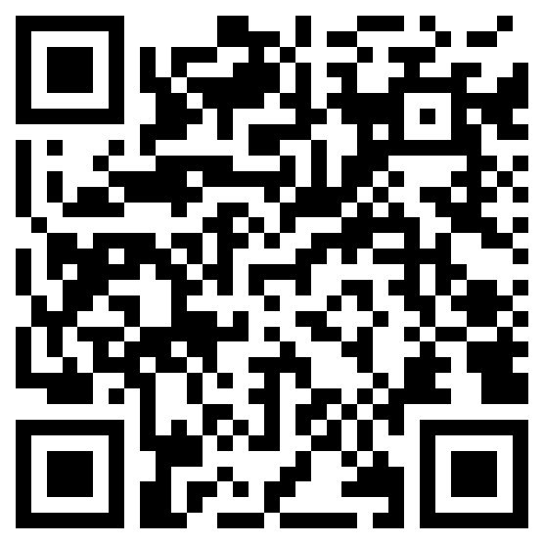
Data We Will Be Working With!
https://www.baseball-reference.com/
Google ‘baseball reference.com’
Use QR Code
There is 9 total people on the project, so 3 will look at hitting, 3 will look at pitching, and 3 will work on fielding
Choose 1 yearly team dataset in your category and we will be finding that table from every year from 2000 to 2021

Slide 10
Kahoot Time!

Slide 11
To Do By Next Week
Familiarize yourself with the project expectations and schedule
Save the link to the Google Drive
Look at the data, and decide which aspect you would like to look at (hitting, pitching, or fielding) and fill out the Google Form for it
Fill out the When2Meet for when next week’s meeting will be
Be ready to work and challenge yourself!

Slide 12
Preview for Next Week
Web Scraping Data from Baseball Reference (heads-up: you will not be allowed to download any csv files or any data files and read them into Python)
Working with requests, BeautifulSoup, and Pandas

Slide 13
Have a great week and great 4th of July if you celebrate!

